Slide 1
ANDROID – PART 2
Activity Lifecycle, Fragments

Slide 2
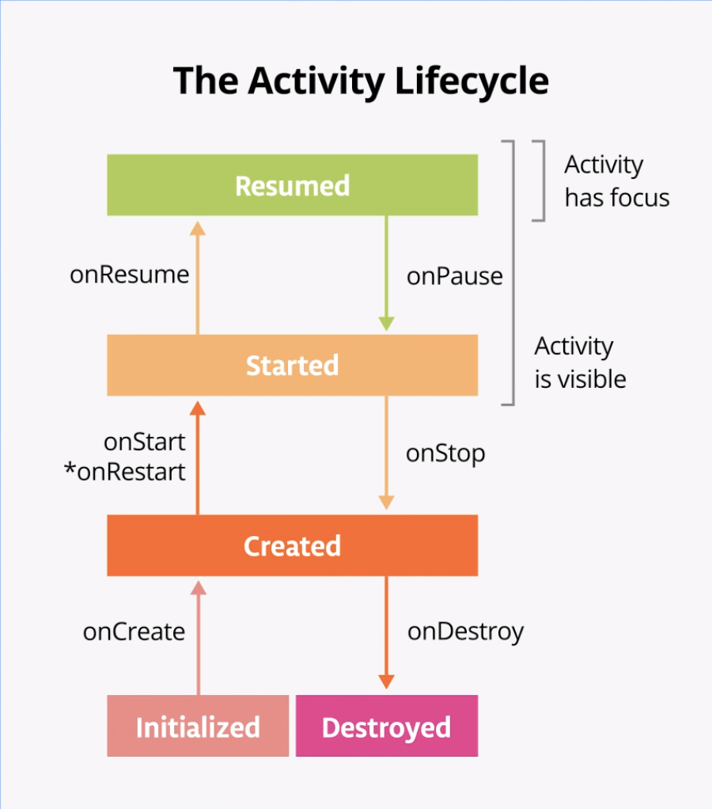
Activity lifetime
State machine for activities
Android tells you about significant events
Your app might want to clean up when it
goes to the background
Trend away from explicit callbacks

Slide 3
Fragment
A Fragment is a combination of an XML layout file and a java class much like an Activity.
Using the support library, fragments are supported back to all relevant Android versions.
Fragments encapsulate views and logic so that it is easier to reuse within activities.
Fragments are standalone components that can contain views, events and logic.

Slide 4
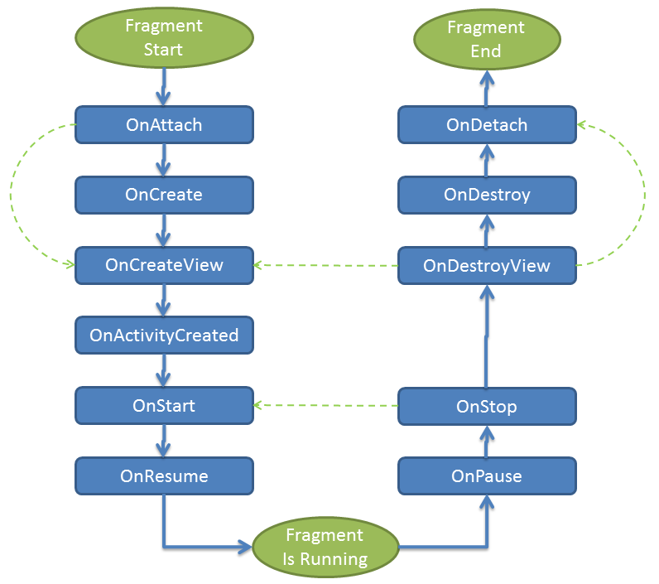
Fragments
Fragment lifetime

